Slide 1
Cryptic COVID
Contact Apps
What is the state of the art for
Coronavirus contact tracing apps?

Slide 2


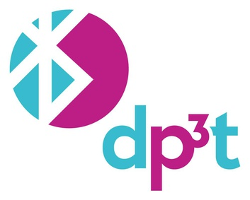

What this talk is:
An appraisal of the current proposed methods for contact tracing apps, focusing on those utilising Bluetooth or BLE.
We focus on three main implementations:
NHS Colocate
BlueTrace
Apple/Google Contact Tracing

Slide 3
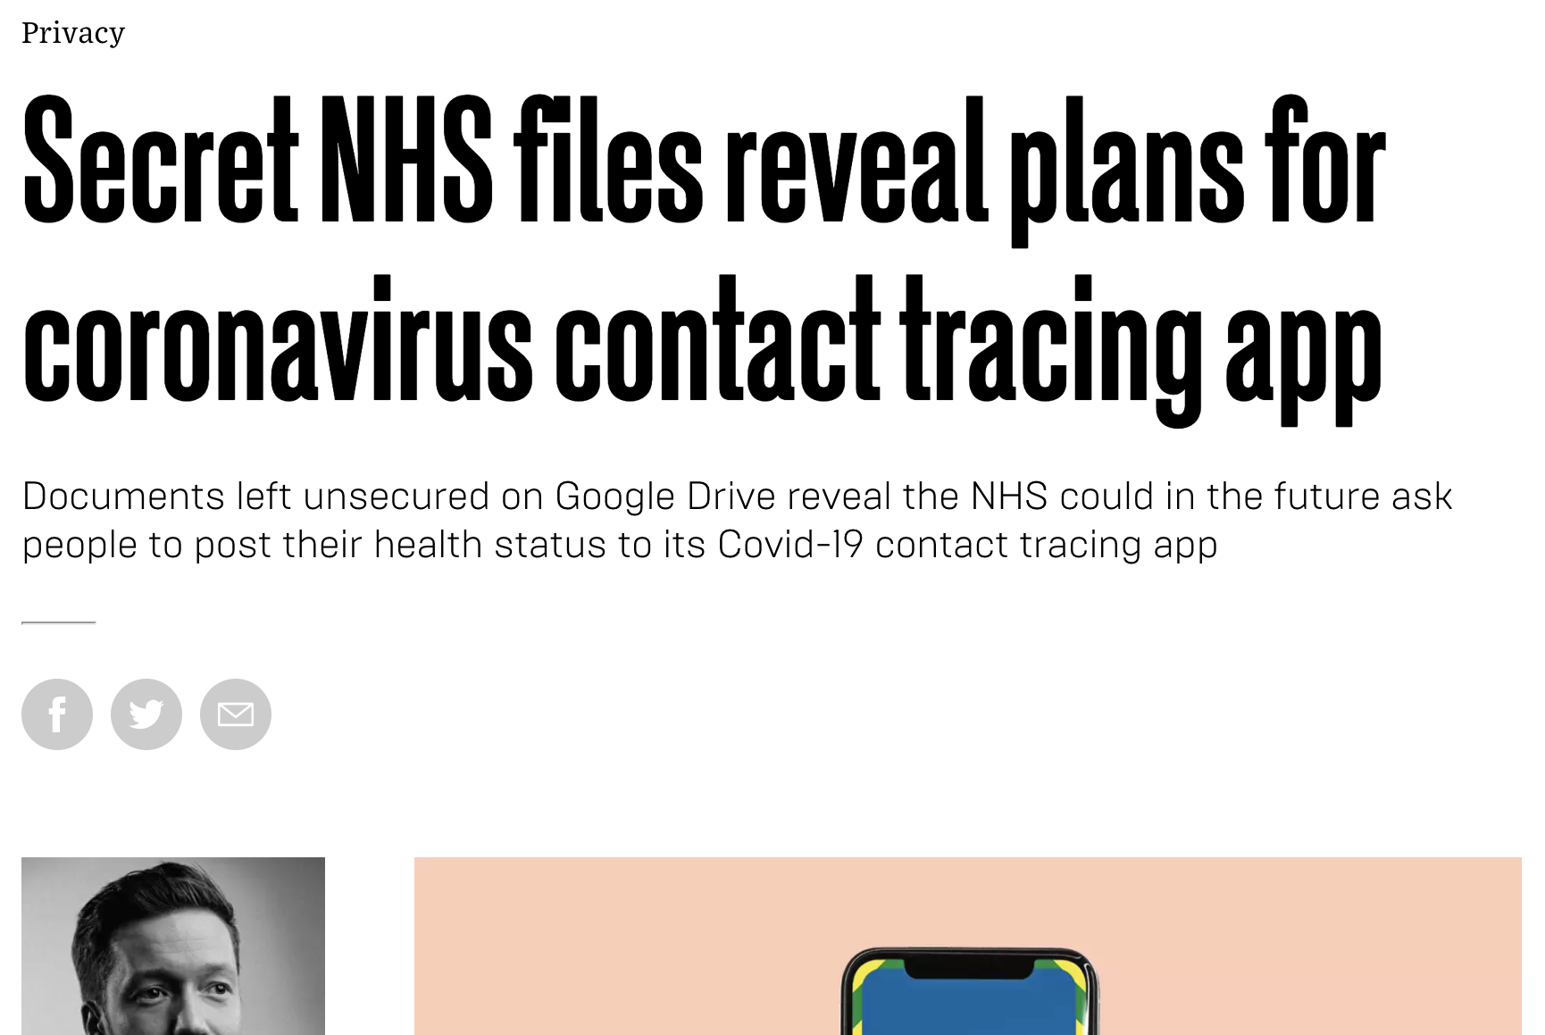
What this talk is not:

Slide 4

What this talk is not:

Slide 5
Central Focus of this talk -
Cryptography, Privacy, and Design
We focus on the implementation of cryptography in these proposed/supplied solutions with the following focal points:
Cryptography and protocol construction
How are these protocols put together, and what primitives do they use?
Privacy Preservation and Considerations
How well are privacy concerns handled? Are there areas in need improvement?
Implementation issues and fidelity
How faithful are the apps to their original designs, and what implementation issues are there?

Slide 6
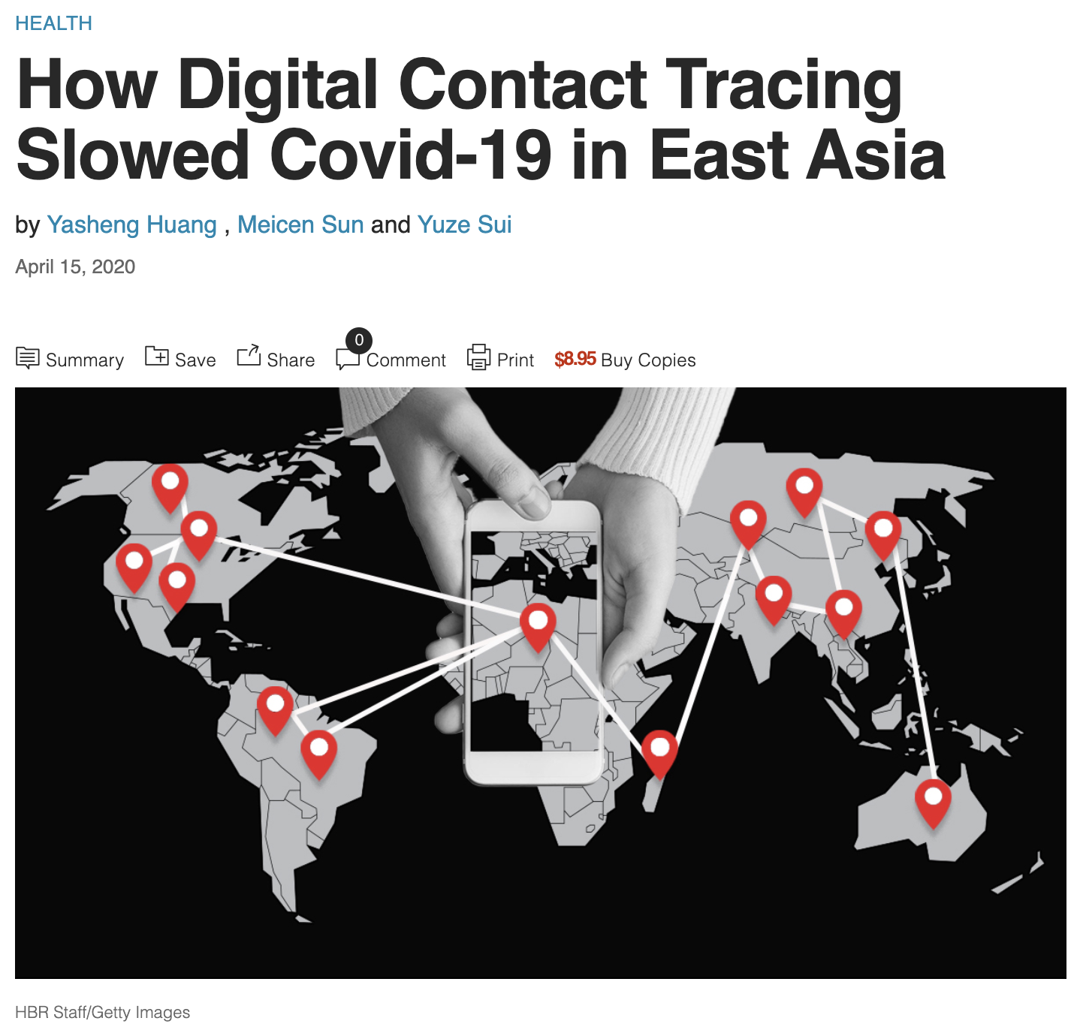
But Why are we developing these?
https://hbr.org/2020/04/how-digital-contact-tracing-slowed-covid-19-in-east-asia

Slide 7
Technology Options
Passive Options
Active Options
GPS
Accuracy to 6ft diameter around receiver is not great for contact/proximity tracing
GPS
Accuracy to 6ft diameter around receiver is not great for contact/proximity tracing
WiFi
Consumes lots of power in AP mode, and probably too loud to be useful
WiFi
Consumes lots of power in AP mode, and probably too loud to be useful
SS7
The telco backbone network has capability for working out location, but to worse granularity
SS7
The telco backbone network has capability for working out location, but to worse granularity
BLE
Low power and reaosnable to use, but has active privacy preserving properties (rolling MACs) to make it hard to track
BLE
Low power and reaosnable to use, but has active privacy preserving properties (rolling MACs) to make it hard to track

Slide 8
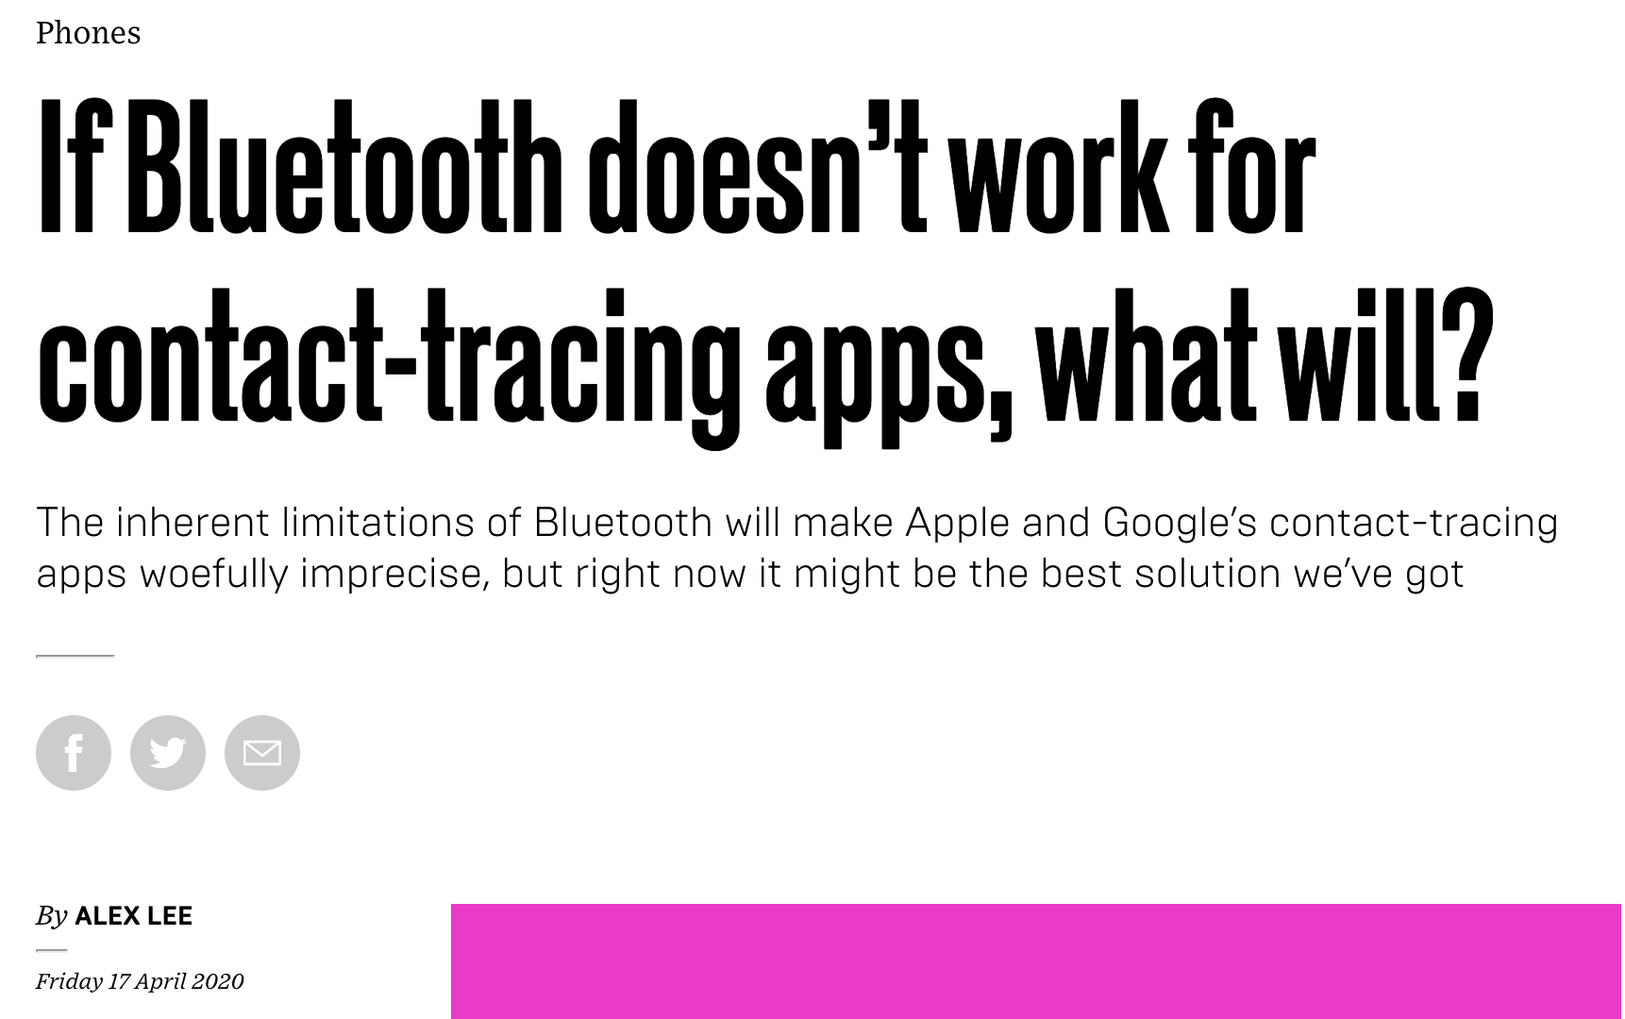
Side note: Bluetooth/BLE is not designed for this...
https://www.wired.co.uk/article/bluetooth-contact-tracing-apps

Slide 9
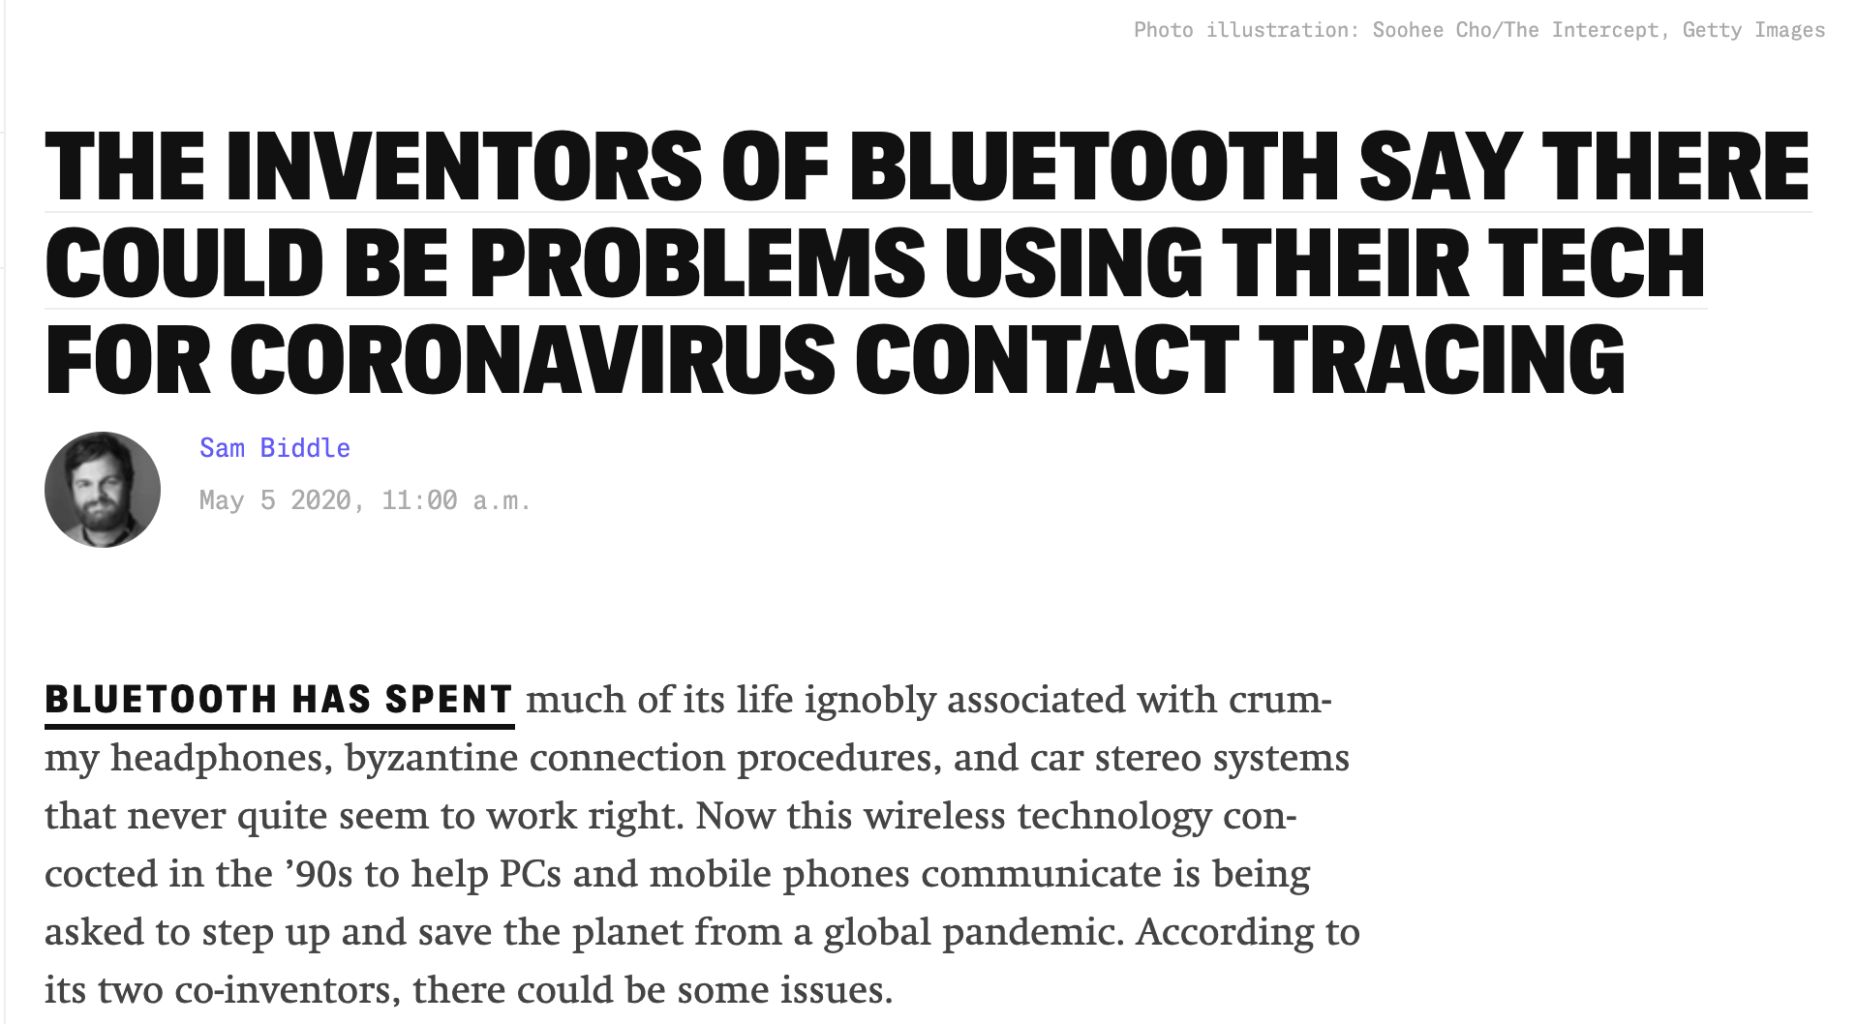
There may even be some very core issues...
https://theintercept.com/2020/05/05/coronavirus-bluetooth-contact-tracing/

Slide 10
NB - SARS-CoV-2 can be spread by people who are asymptomatic.

Slide 11
The overall workflow for a contact tracing app:
1
2
3
Onboarding
Generate unique identifiers for each user
Contact Tracing
Generate information for which users have been in contact by swapping unique IDs
Notification
If a COVID-19 infection is confirmed, notify users who had potential contact

Slide 12


General idea of BLE-based contact tracing apps
👩‍💼
UserID
👨‍💼
UserID
2
BLE Broadcast
1
1
3
Contact Notification
Diagnosis Notification
3

Slide 13
Privacy and Security Considerations
👩‍💼
UserID
👨‍💼
UserID
BLE Broadcast
Can any part
of this workflow
be compromised?
Contact Notification
Diagnosis Notification

Slide 14
Privacy and Security Considerations
Can a malicious actor determine who is who?
Can broadcasts be spoofed?
👩‍💼
UserID
👨‍💼
UserID
BLE Broadcast
Contact Notification
Diagnosis Notification

Slide 15
Privacy and Security Considerations
👩‍💼
UserID
👨‍💼
UserID
BLE Broadcast
Contact Notification
Diagnosis Notification
Can privacy be preserved if someone notifies of a diagnosis?

Slide 16
NHS Contact Tracing App (uk.nhs.nhsx.colocate version)

Slide 17
Back story regarding the NHS app
App draft design document released late April 2020
First candidate apps for Android and iOS released on 6th May 2020 for Isle of Wight users
8th May - work on second app announced, using Google-Apple model, consulted on by a Swiss cryptography firm.

Slide 18
All parties get the server’s master public key, generate their own keys, and perform ECDH
👩‍💼
InstallationID
All users generate an InstallationID, and receive the server’s master public key (set using curve P256 ECC)
👨‍💼
InstallationID
Server Public key
Server Public Key
User Public Key
User Public Key
Users generate and send their ECC public keys, and then all parties perform ECDH to generate mutual keys ZA, ZB, etc.
Server has:
Key ZA, PubKeyA
Key ZB, PubKeyB

Slide 19
Alice derives her Broadcast Value (BV):
👩‍💼
ZA
InstallIDA
👨‍💼
ZB
InstallIDB
Key, IV = KDF(ZA, PubKeyA)
M = (Start||End||InstallID||Country)
Cipher,ICV=AESGCM(M, IV)
BV = (Country||PubKeyA||C||ICV)
Non-maths explanation - Each user generates a value BV that is their public identifier for that day.
Server has:
Key ZA, PubKeyA
Key ZB, PubKeyB

Slide 20
User derives the daily Broadcast Value and sends it out:
👩‍💼
ZA
InstallIDA
👨‍💼
ZB
InstallIDB
(Country||PubKeyA||C||ICV) = BV
P
P = (BV||TxPower||TxTime||Auth)
Server has:
Key ZA, PubKeyA
Key ZB, PubKeyB

Slide 21
Diagnosis Notification Workflow
👩‍💼
InstallID
😷
InstallIDC
Contact Notification
Diagnosis Notification
Server uses same algorithm as users to work out InstallIDC by means of the master private key.
From here, it can work out all of their BV values, and then see who they were in contact with.

Slide 22
Benefits and Drawbacks of the NHSX approach
Pros | Cons
Central management takes care of individual notifications - data isolation means no potential for delayed compromise.. | Very heavy processing required by the central services to derive and notify those who need to be after a diagnosis is declared.
Strong Cryptographic primitives are used (AESGCM, P256 ECC, etc.) | Single Master key for the whole system is a potential single point of failure.
 | Much of the cryptography seems unnecessary.
 | Broadcast Values (BVs) are static for a whole day - this could permit temporary tracking by third parties.

Slide 23
The single master key design is archaic, and completely unsuitable for a modern system.

Slide 24
In this protocol and system, the loss of the master key would lead to total failure of the system - which is a bad design decision.

Slide 25
The real danger is that such a bad design could likely be replicated and copied by developers unaware of the issues, but observant that ‘it was good enough for NHSX’.

Slide 26
There doesn’t seem to be any benefit of the Z key:
The InstallIDs could be generated iteratively, or generated randomly and sent via signed message to the server… So no value in Z here.
👩‍💼
ZA
via ECDH
👨‍💼
ZB
via ECDH
User Public Key
User Public Key
If the server infrastructure is compromised, the database and master keys are likely compromised, so the Z key offers no value in this sense.
Server has:
InstallIDs
Key ZA, PubKeyA
Key ZB, PubKeyB

Slide 27
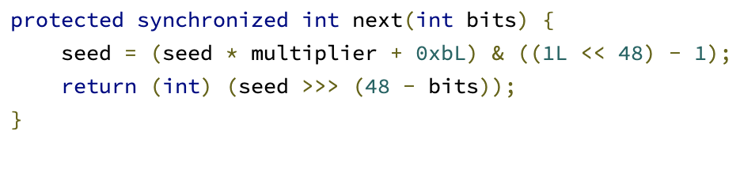
Notes on the Implementation
The app makes use of the BouncyCastle cryptographic library - they claim this is for ‘point-value access to the ECC curve’.
However, the ECC implementation there makes use of java.util.Random (as opp. to java.util.SecureRandom)
However, BouncyCastle have indicated there should be no issue. But there does not seem to be a straightforward answer as to precisely why it is used for some parts of the cryptography, when the rest of the code seems to use the better JavaX codebase for cryptography.

Slide 28
My overall assessment of the NHSX system is that it is just...
...really odd.

Slide 29
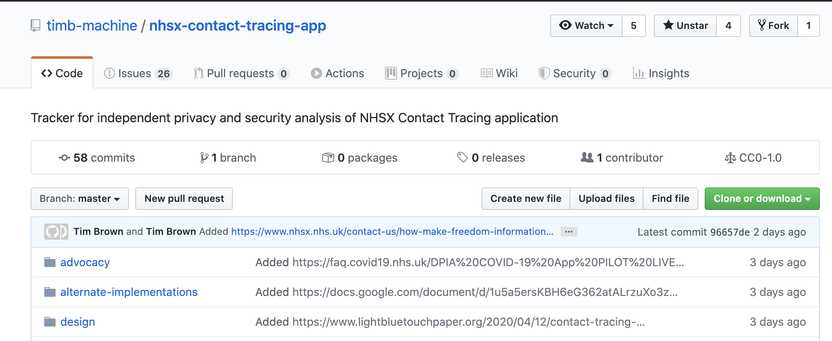
Tim Brown’s gathering repo of resources
Tim Brown (@timb_machine) is gathering information, resources, and articles about the NHSX app(s) here:
https://github.com/timb-machine/nhsx-contact-tracing-app

Slide 30
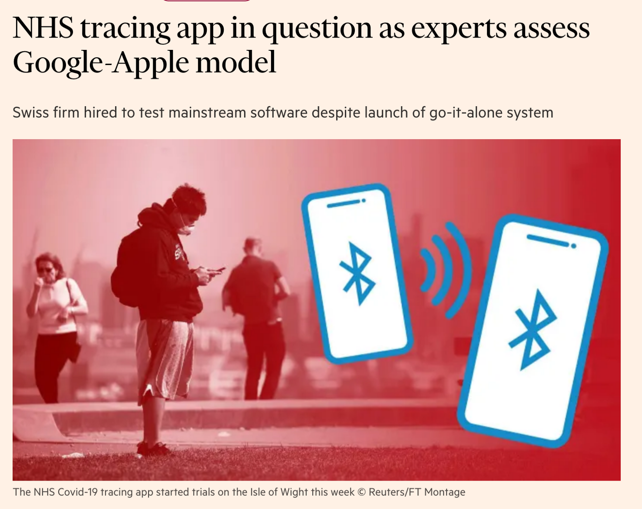
Resources for the NHSX app
Blog posts by Prof. Bill Buchanan:
https://medium.com/@billatnapier/the-crypto-on-the-nhsx-covid-19-app-is-a-thing-of-maths-beauty-53b2434d13cb
https://medium.com/asecuritysite-when-bob-met-alice/the-uk-contact-tracing-app-version-2-69010db3394d
NCSC Documentation on the Cryptographic Security of this app:
https://www.ncsc.gov.uk/files/NHS-app-security-paper%20V0.1.pdf
Good luck to Zuhlke Engineering in working on the next version of this app - enjoy the £3.8mil.

Slide 31
BlueTrace - ref. Implementation OpenTrace

Slide 32
Background to the BlueTrace Protocol
Developed by the Singaporean government for the TraceTogether coronavirus tracing app.
Works differently from the NHS app by the fact that the HA supplies each user with a traceID.
Utilises BLE in a similar way to other protocols and methods.
The open source implementation OpenTrace is not to be confused with the OpenTracing debug s/w.

Slide 33
User Registration
Each user submits their phone number to the main server, which then assigns them a unique, randomly generated UserID.
Each User is given by the server:
C,Auth = AES256GCM(UserID||Start||End)
TempID = (C || IV || Auth)
Only the HA knows the secret master AES256 key that is used to encrypt these values.
Temp IDs are time limited, as determined by the server.
👩‍💼
TempID
Phone Number
TempID
Server has:
UserID
PhoneNum

Slide 34
TempIDs Recorded by Users they come into contact with
👩‍💼
TempID
👨‍💼
TempID
TempID
Each user logs their interactions by storing the TempIDs, the RSSI of the BLE, the make/model of the phone, timestamp, etc.
Server has:
UserID
PhoneNum
MasterAESKey

Slide 35
Diagnosis Notification Workflow
👩‍💼
TempID
😷
TempIDC
Notification (by SMS)
Diagnosis Notification
If a diagnosis is confirmed, then the user is instructed to use the app to send their entire history of observed TempIDs, replete with timestamps, etc. to the main server.
The HA then contacts the people that they determine to be at risk.

Slide 36
Benefits and Drawbacks of the BlueTrace approach
Pros | Cons
Complete central control make the user processing minimal - and out of band notification means the app is expendable. | Single Master key for the whole system is a potential single point of failure, as for NHSX.
Strong Cryptographic primitives are used (AES256GCM in particular.) | Opting out relies wholly on the central authority, which has PII for each user.
Users have complete control over whether they send data to the HA. (Good for privacy) | Users have complete control over whether they send data to the HA (bad for calculations and malicious activity detection).

Slide 37
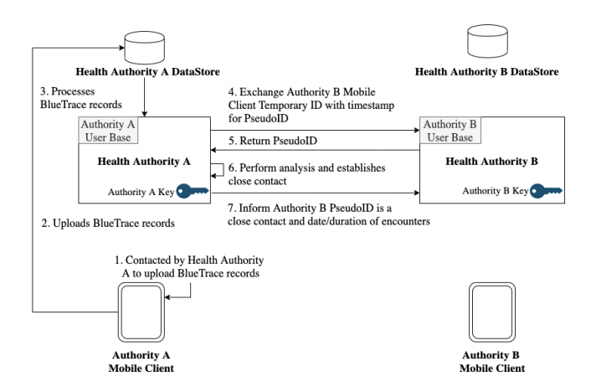
Notes on the Implementation
The OpenTrace implementation is wholly written in Kotlin - and it should be noted that Kotlin does not currently have a good random number generator.
(see: https://github.com/Kotlin/KEEP/issues/184)
The Whitepaper has provision for the user to generate their UserID. At the moment they are using Java’s RandomUUID through a Kotlin wrapper - this uses java.util.SecureRandom, so all is fine.
Given the centrality of storage, the whitepaper makes provision for the sharing of data between HAs.

Slide 38
Resources for the BlueTrace Protocol
The BlueTrace Website:
https://bluetrace.io
The BlueTrace Whitepaper:
https://bluetrace.io/static/bluetrace_whitepaper-938063656596c104632def383eb33b3c.pdf
Opentrace FOSS implementation:
https://github.com/OpenTrace-community

Slide 39
The Gapple Protocol

Slide 40
The Appoogle Protocol

Slide 41
The Google-Apple Protocol

Slide 42
Back story regarding the Google-Apple protocol
First announced on 10th April - everyone has a little cry… https://blog.google/inside-google/company-announcements/apple-and-google-partner-covid-19-contact-tracing-technology/
Germany goes along with this technology on 26th April 2020, having been initially reticent to using it. Singapore cite this as their inspiration for their BlueTrace protocol.
The UK sidesteps the use of the protocol on 28th April 2020 - https://healthtech.blog.gov.uk/2020/04/24/digital-contact-tracing-protecting-the-nhs-and-saving-lives/

Slide 43
Overview of Key Terms
Exposure Notification Service — The Bluetooth Low Energy service for detecting device proximity.
Temporary Exposure Key — A key that’s generated every 24 hours for privacy consideration.
Diagnosis Key — The subset of Temporary Exposure Keys uploaded when the device owner is diagnosed as positive for the coronavirus.
Rolling Proximity Identifier — A privacy preserving identifier derived from the Temporary Exposure Key and sent in the broadcast of the Bluetooth payload.
Associated Encrypted Metadata (AEM) — A privacy preserving encrypted metadata that shall be used to carry protocol versioning and transmit (Tx) power for better distance approximation. The Associated Encrypted Metadata changes about every 15 minutes, at the same cadence as the Rolling Proximity Identifier, to prevent wireless tracking of the device.

Slide 44
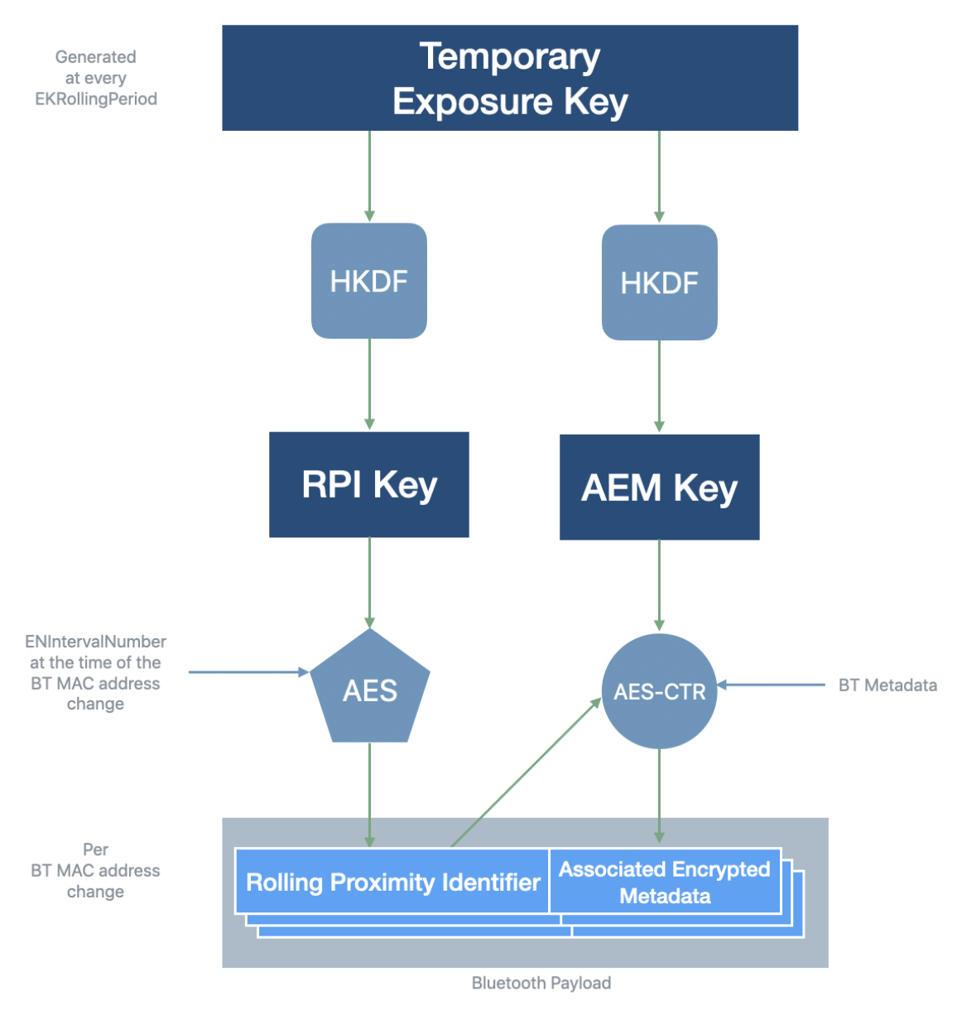
How Tokens are generated - fully independent of any HA Infrastructure:
👩‍💼
TEKey
TEKey
The users’ devices each generate a Temporary Exposure Key (TEKey) that is fresh for each day. There is no contact with the server at all during this phase.

Slide 45
How Tokens are generated - fully independent of any HA Infrastructure:
👩‍💼
TEKey
👨‍💼
TEKey
RPI
Each device generates Rolling Proximity Keys (RPIK) from the TEKey, which then generates a stream of Rolling Proximity Identifiers (RPI) from
AES128CTM(RPIK, PaddedData)
Any detected RPIs are stored with ‘Associated Encrypted Metadata’, with a key that changes at the same rate as the RPIK.

Slide 46
Diagnosis Notification Workflow
👩‍💼
😷
TEKeys
Diagnosis Keys
TEKeys (last 14 days)
The user apps download all available Diagnosis Keys.
The device then generates all possible RPIs for a given TEKey. The system then checks through the AEM to see if the user has been in contact with a diagnosed patient.
If a diagnosis is confirmed, then the last 14 TEKeys from the device are sent to the Diagnosis Server, and become Diagnosis Keys.
These are made available for download publicly.

Slide 47
Benefits and Drawbacks of the BlueTrace approach
Pros | Cons
The app relies on minimal server infrastructure. | Prone to replay attacks (but then again, so are all the others in this talk)
Strong privacy considerations - the app works mostly without any deliberate disclosure. | Relatively weak ciphers used (AES128-CTR) but not detrimentally so.
Suited for low power implementations owing to lightweight algorithms in use.
An interesting article about issues with this, and other, contact tracing apps: https://eprint.iacr.org/2020/428.pdf

Slide 48
Resources for the Google-Apple Protocol
Original Design Documentation site:
https://www.apple.com/covid19/contacttracing
Gavili, Yavron - “SECURITY ANALYSIS OF THE COVID-19 CONTACT TRACING SPECIFICATIONS BY APPLE INC. AND GOOGLE INC.”
https://eprint.iacr.org/2020/428.pdf
Apple-Google reference design on Github:
https://github.com/google/exposure-notifications-android
Announcement Article:
https://www.google.com/covid19/exposurenotifications/

Slide 49
DP^3T - Apple-Google protocol with more eyes and nice features

Slide 50
DP-3T: Apple-Google 2.0? Quick overview of DP-3T
Structurally - the protocol is the same as the Apple-Google protocol. Users provision their own seeds that generate tokens for BLE broadcast.
Adjustable Seed Windows - usually set between 2-4hrs, the seeds have much shorter lives, meaning that users can choose which parts of a day’s activity they with to disclose.
This preserves privacy much more effectively, whilst also helping to mitigate fake malicious retransmissions if timestamps are checked.
Optimised user search - for matching observed tokens to diagnosis keys with minimal download key sizes, by means of Cuckoo filters.
https://github.com/DP-3T/documents/blob/master/DP3T%20White%20Paper.pdf

Slide 51
Overview of the Presented Solutions
Criteria: | NHSX Co-locate | BlueTrace | Apple- Google | DP-3T
Cryptographic Primitives in Use | 😁 | 😁 | 🤨 | 😁
Cryptographic Design
Privacy Considerations
Faithfulness of Implementations

Slide 52
Overview of the Presented Solutions
Criteria: | NHSX Co-locate | BlueTrace | Apple- Google | DP-3T
Cryptographic Primitives in Use | 😁 | 😁 | 🤨 | 😁
Cryptographic Design | 😬 | 😕 | 🙂 | 😁
Privacy Considerations
Faithfulness of Implementations

Slide 53
Overview of the Presented Solutions
Criteria: | NHSX Co-locate | BlueTrace | Apple- Google | DP-3T
Cryptographic Primitives in Use | 😁 | 😁 | 🤨 | 😁
Cryptographic Design | 😬 | 😕 | 🙂 | 😁
Privacy Considerations | 🤔 | 🙄 | 😊 | 😊
Faithfulness of Implementations

Slide 54
Overview of the Presented Solutions
Criteria: | NHSX Co-locate | BlueTrace | Apple- Google | DP-3T
Cryptographic Primitives in Use | 😁 | 😁 | 🤨 | 😁
Cryptographic Design | 😬 | 😕 | 🙂 | 😁
Privacy Considerations | 🤔 | 🙄 | 😊 | 😊
Faithfulness of Implementations | 🧟‍♂️ | 💩 | 👍 | 👍

Slide 55
Further Reading:
DP-3T - https://github.com/DP-3T/documents
PEPP-PT NTK - https://github.com/pepp-pt/pepp-pt-documentation
ROBERT - https://github.com/ROBERT-proximity-tracing/documents
East Cost PACT - https://pact.mit.edu/
West Coast PACT - https://arxiv.org/abs/2004.03544
Anonymous Collocation Discovery: Harnessing Privacy to Tame the Coronavirus - https://arxiv.org/abs/2003.13670
Temporary Contact Numbers (TCN) - https://github.com/TCNCoalition/TCN, https://www.covid-watch.org/
TraceSecure: Towards Privacy Preserving Contact Tracing - https://arxiv.org/abs/2004.04059

Slide 56
Acknowledgements
Questions or Comments?
Anne Weine (@AnilamAnn)
Tash (@TashJNorris), Dawid (@insomnious0x01), and Emelie (@emeliejhp)
Colleagues - Dan, Ashley, Stu, Vlad, Evangelos, Adam, and Freddie.

